Slide 1
Python Machine Learning In Biology:
Tour of Machine Learning Classifiers
Nichole Bennett

Slide 2


Slide 3
Modeling
You probably a good idea of how long it takes you to get to work from your house.
All humans naturally model the world around them.
Over time, your observations about transportation have built up a mental dataset and a mental model that helps you predict what traffic will be like at various times and locations. You probably use this mental model to help plan your days, predict arrival times, and many other tasks.
As scientists we attempt to make our understanding of relationships between different quantities more precise through using data and mathematical/statistical structures. This process is called modeling.

Slide 4
Modeling
Models are simplifications of reality that help us to better understand that which we observe.
In a science setting, models generally consist of an dependent variable (or output) of interest and one or more independent variables (or inputs) believed to have an effect on the dependent variable.

Slide 5
Model-Based Inference
We can use models to conduct inference.
Given a model, we can better understand relationships between an independent variable and the dependent variable or between multiple independent variables.
All models are wrong. Some models are useful.
What are some examples of where inference from a model would be valuable in your research?

Slide 6
Prediction
We can use a model to make predictions, or to estimate an dependent variable's value given at least one independent variable's value.
Predictions can be valuable even if they are not exactly right.
Good predictions are extremely valuable.
What are some examples of where prediction from a model could be valuable for your research?
What is the difference between model prediction and inference?
Notes:
# Prediction is making guesses about future scenarios based on data and a model constructed on that data.
# Inference is judging what the relationship, if any, there is between the data and the output.

Slide 7

“No Free Lunch” Theorem
No single classifier works best across all possible scenarios.
Usually a good idea to compare the performance of a few different algorithms.

Slide 8
Classifiers

Slide 9


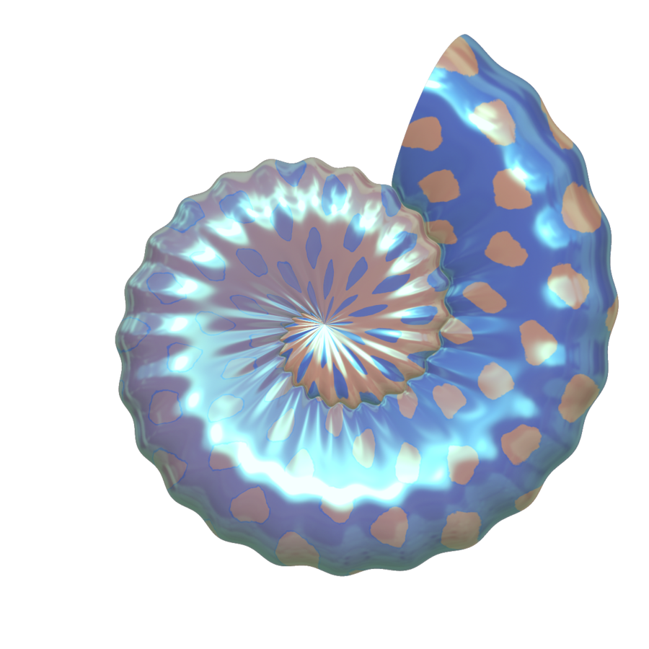
Notes:
Another way to think of it is having a kid draw a line between red shells and blue shells (the goal is to split the data)

Slide 10

Notes:
We want a computer to split the data--we will do this in the same way we found the pencil or descended from the mountain
Classifiers do this by figuring out what shells are near the other shells. They just differ in how they define “nearby”

Slide 11
Notes:
Ok let’s do the same thing with actual data points. Let’s try to draw a line in a random position first

Slide 12
Notes:
Ok let’s do the same thing with actual data points. Let’s try to draw a line in a random position first
Error function--how many points did we misclassify?
Find the position of the line that decreases the error the most
Can we find a better error function? (stairs instead of mountain metaphor)

Slide 13
Notes:
Ok let’s do the same thing with actual data points. Let’s try to draw a line in a random position first
Error function--how many points did we misclassify?
Find the position of the line that decreases the error the most
Can we find a better error function? (stairs instead of mountain metaphor)

Slide 14


Discrete vs. Continuous Error Functions
Discrete Error Function
Continuous Error Function
Notes:
Can we find a better error function? (stairs instead of mountain metaphor)

Slide 15
Logistic Regression
Notes:
Logistic Regression
Every point gets a penalty (wrong ones get big penalty and right ones get much smaller penalty) (picture will have dots that are bigger the bigger the penalty)
Add these penalties together

Slide 16
Logistic Regression
Notes:
Shade in probability gradients

Slide 17
Steps for Training a Machine Learning Classifier
Selection of features
Choosing a performance metric
Choosing a classifier and optimization algorithm
Evaluating the performance of the model
Tuning the algorithm
Notes:
We’ll revisit preprocessing steps, performance metrics, and hyperparameter tuning. Our purposes for today are to get a feel for all of many of the classifier algorithms.

Slide 18
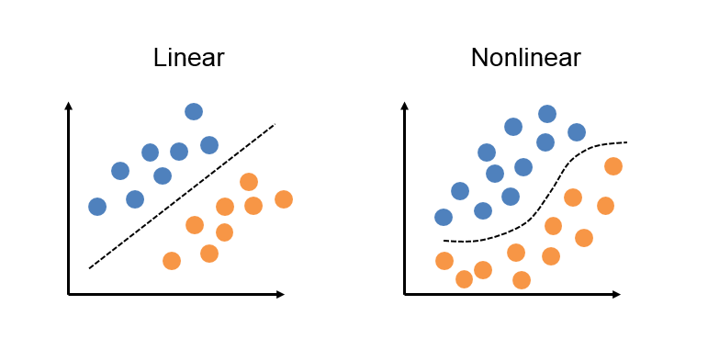
Quick Note: Linearly Separable vs. Not

Slide 19
Logistic Regression
Suppose we have a dataset with two variables in it: one variable we seek to predict (Y) and one independent variable (X) we want to use in order to predict Y. What we would have done previously is to pick a metric (usually mean squared error) and then fit a line of best fit (regression!)
However, what if Y is binary? (not continuous)
What are some examples from our research like this?

Slide 20
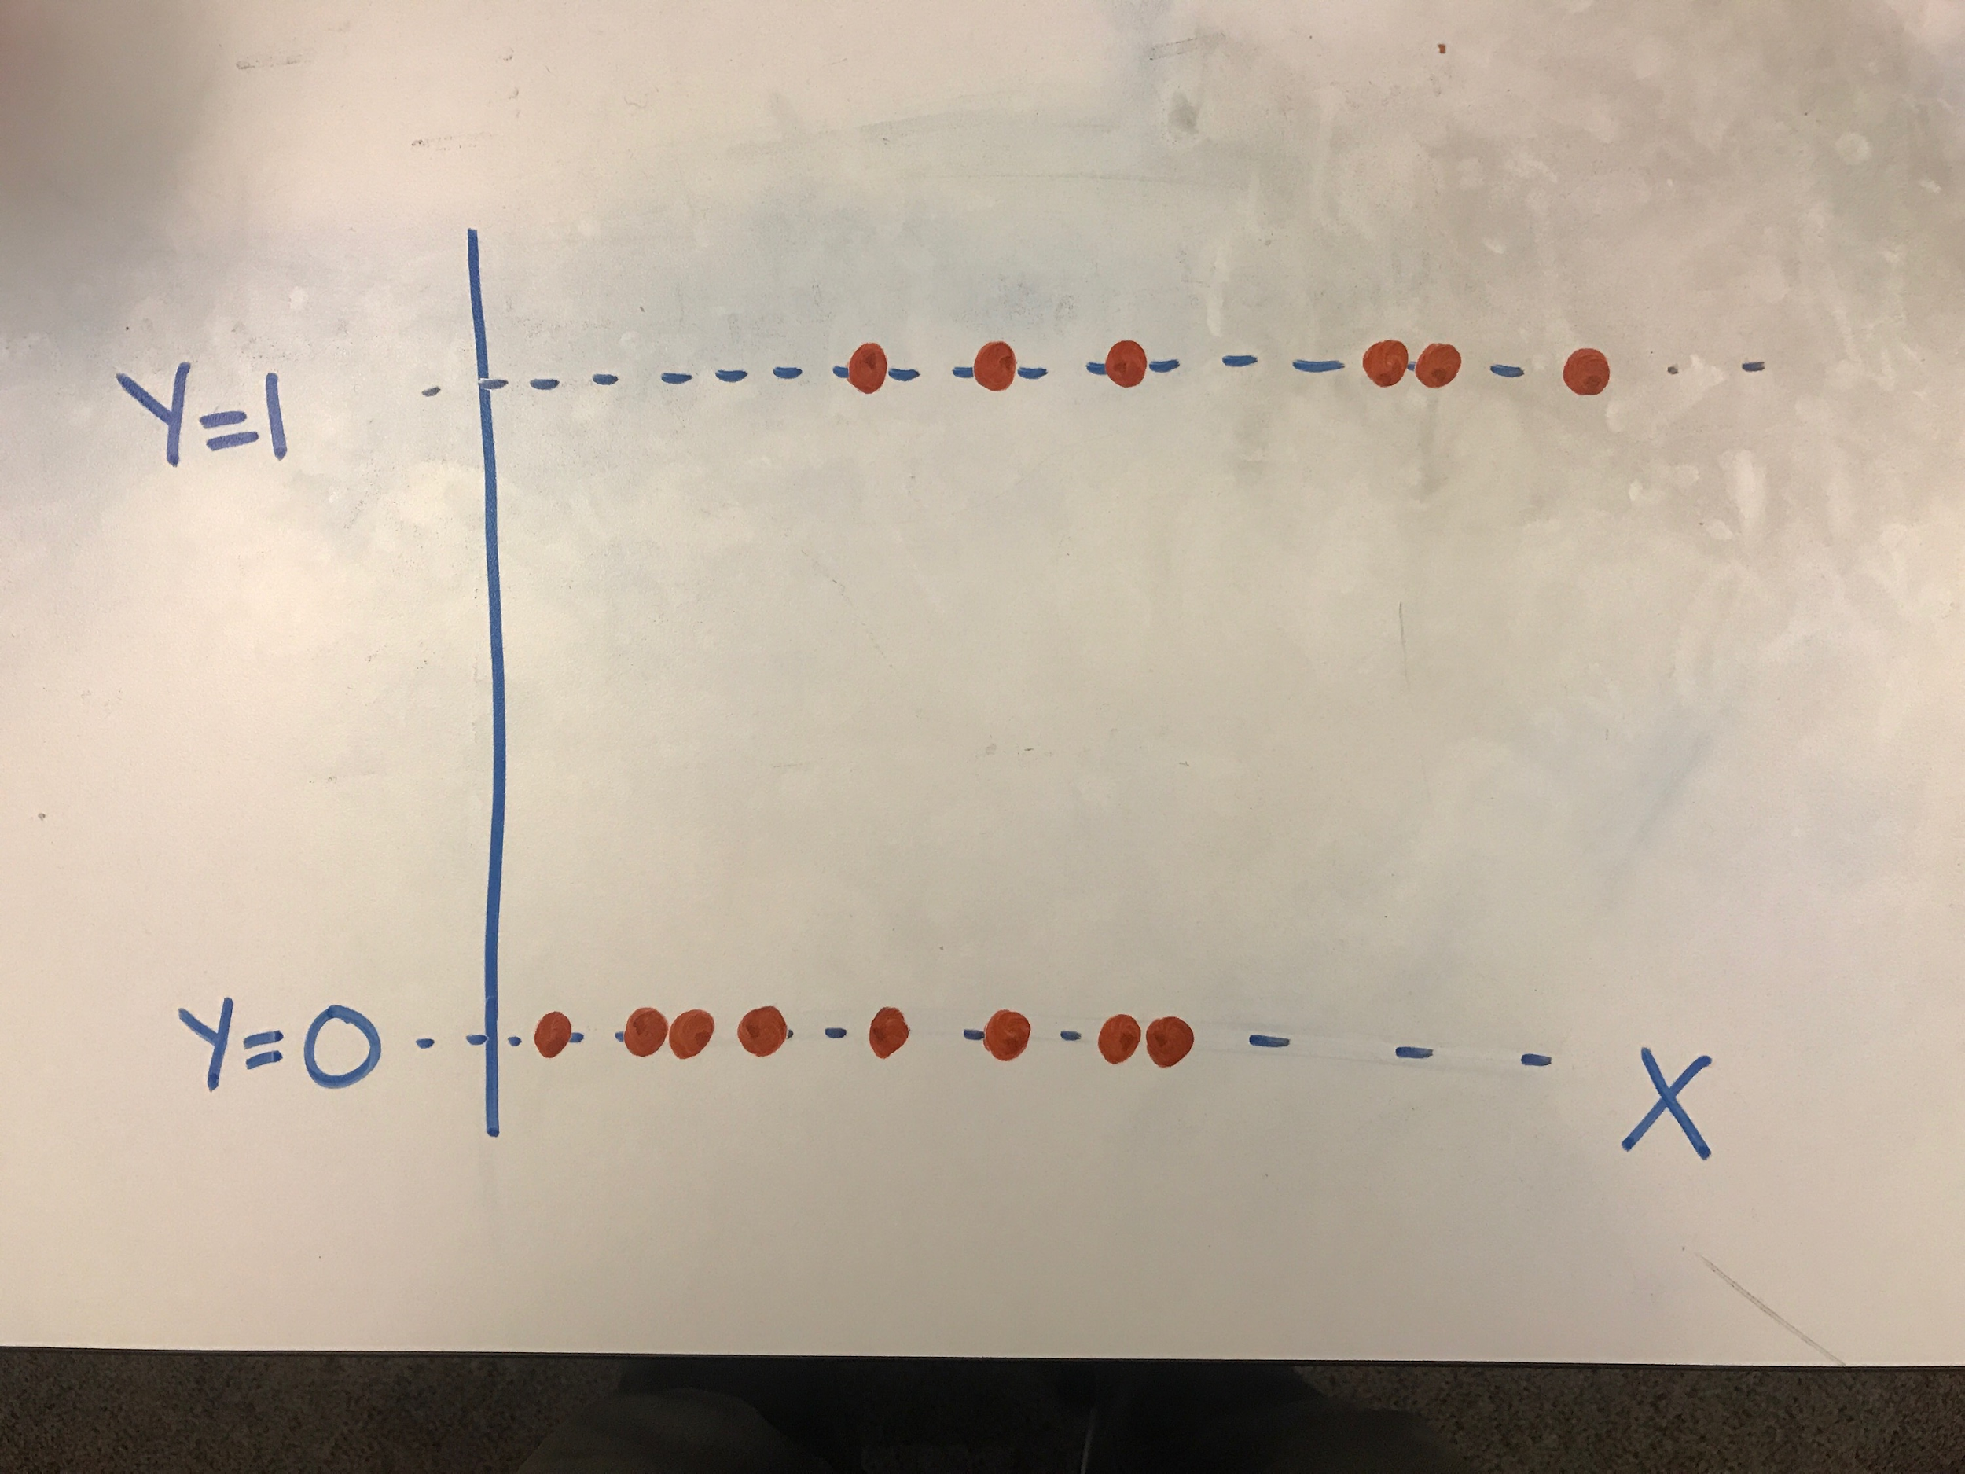
Logistic Regression
After turning our binary variable into a dummy variable appropriate for use in Python, our plot might look something like this.

Slide 21
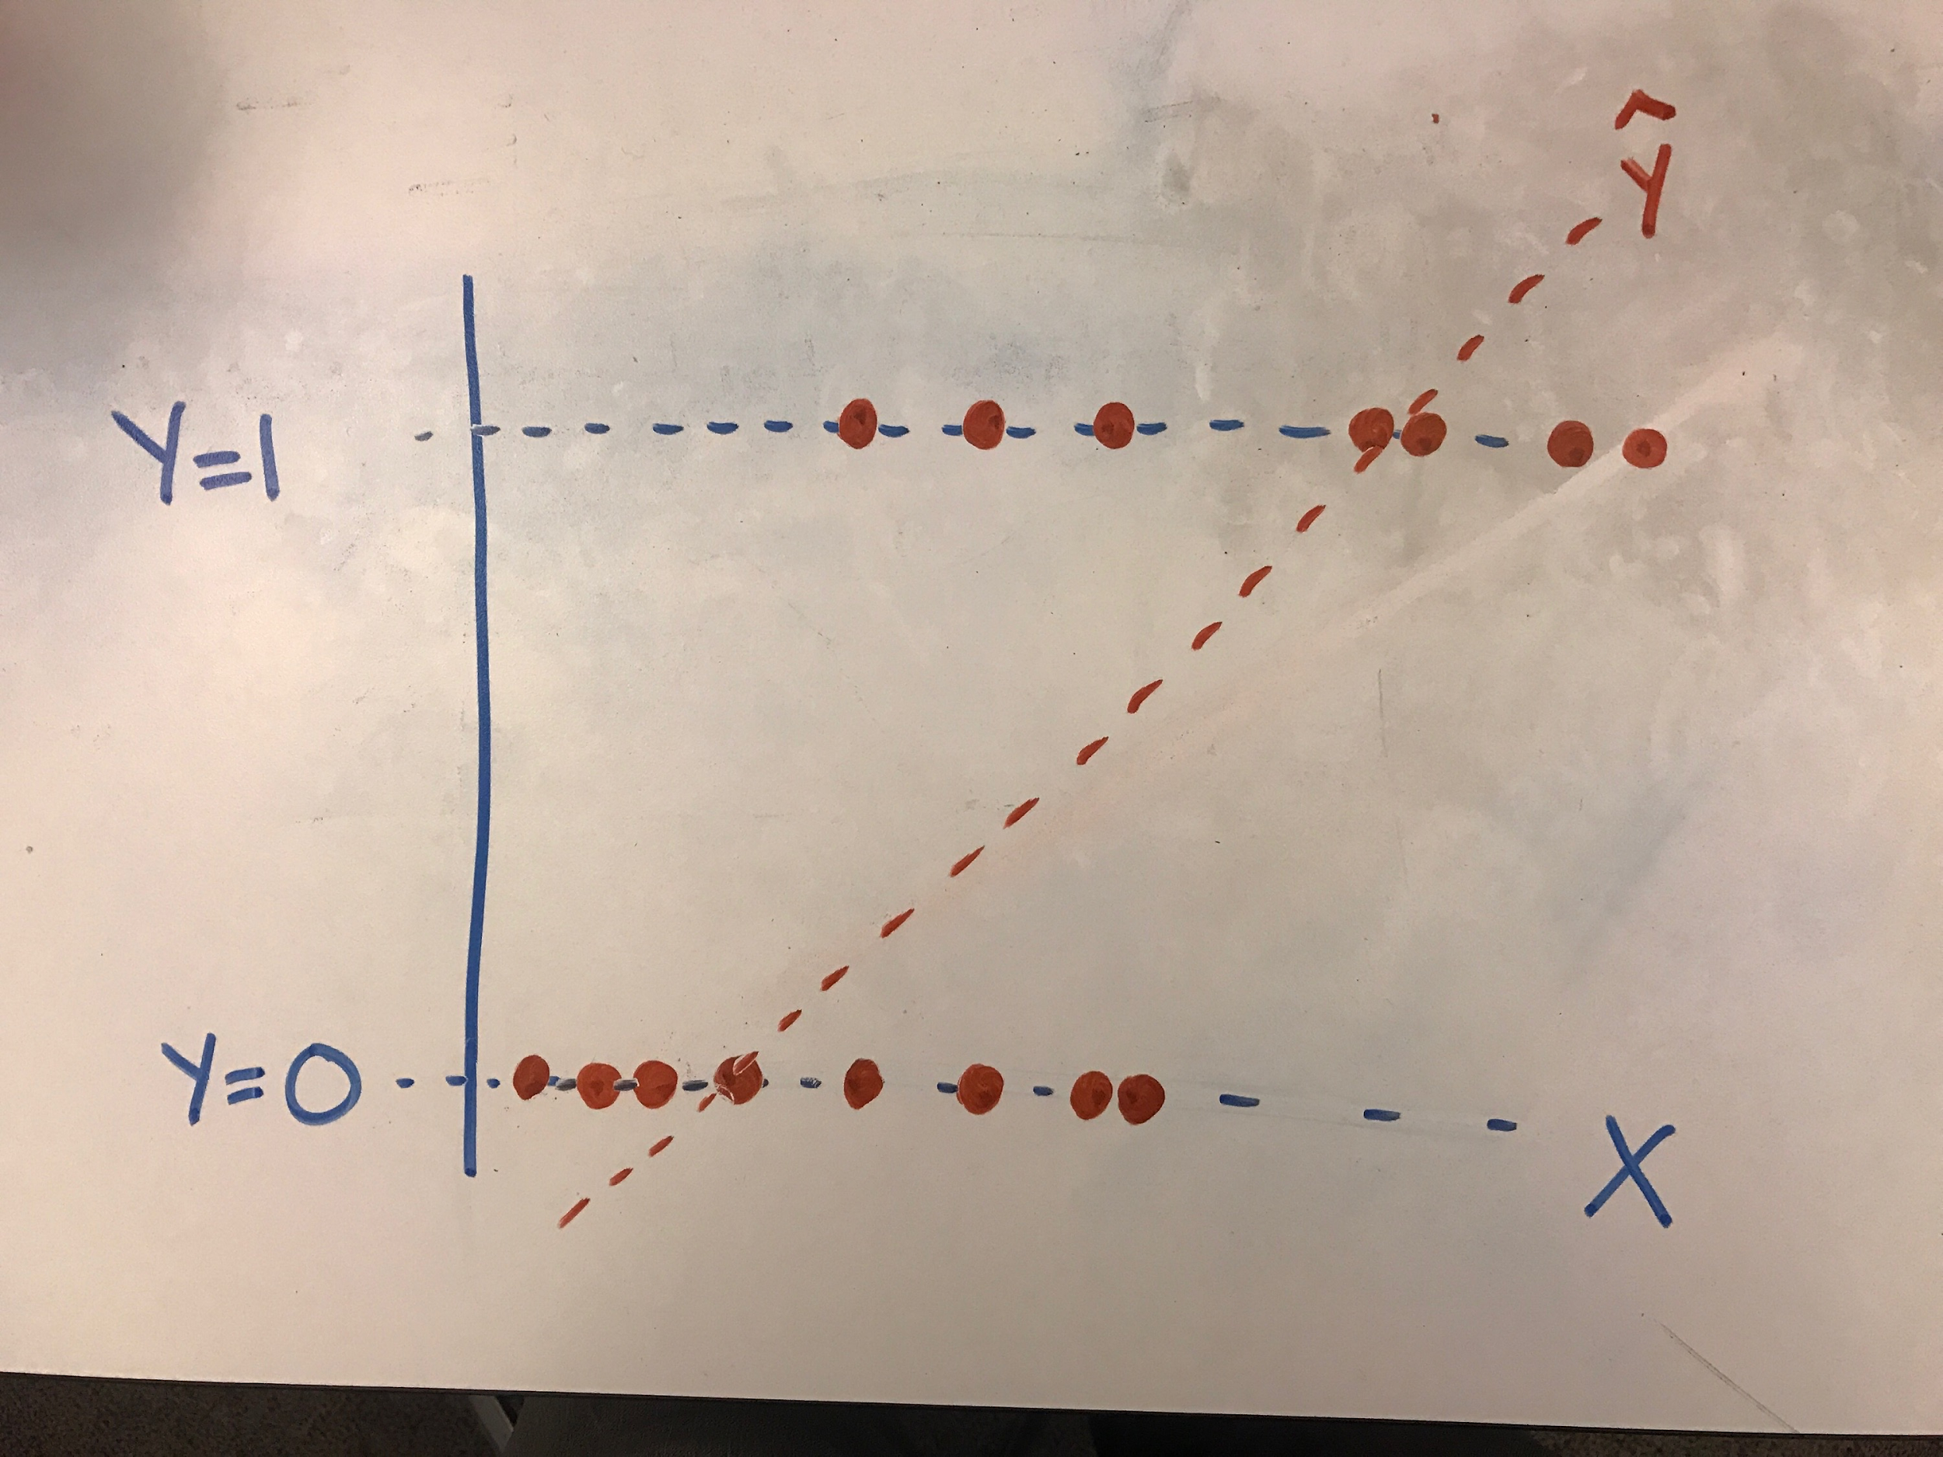
Logistic Regression
If we were to fit a traditional line through it, we'd likely get a line that fits as follows:
Notes:
What problems are there with this?

Slide 22
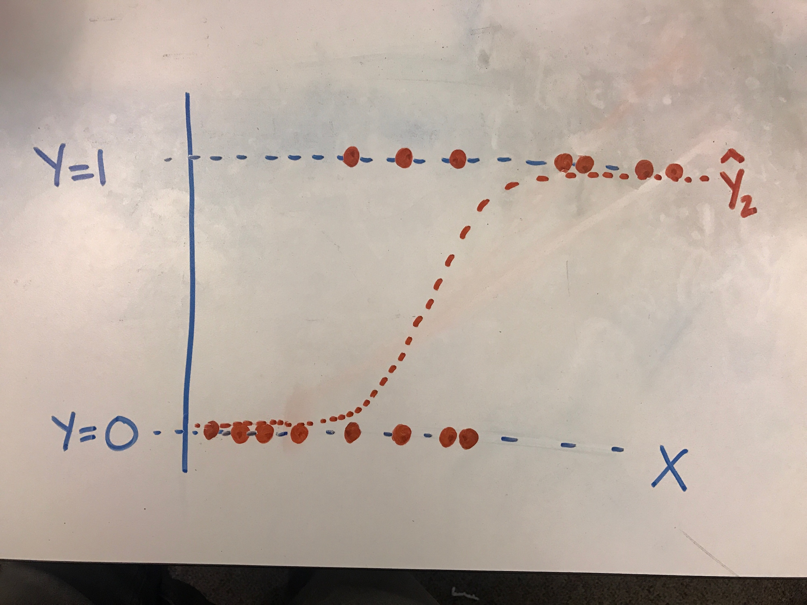
Logistic Regression
Wouldn’t it be great to have a line like this?
Notes:
Logistic regression is a linear approach to solving a binary classification problem. That is, we can use a linear model, similar to linear regression, in order to estimate the probability that an observation falls into a particular category and, based on this probability, provide a "best guess" for in which category the observation likeliest falls.

Slide 23
Logistic Regression
Logistic regression measures the relationship between the dependent data point variables and one or more independent data points by estimating probabilities.

Slide 24
Logistic Regression
The goal of logistic regression is to predict the probability that Y is equal to 1 (rather than 0) given certain values of X. Our model's goal is predicting probabilities - rather than target scores - with our independent variables. Once we get these predicted probabilities, we can classify observations as falling into one category or the other based on the predicted probability.

Slide 25
Logistic Regression
Performs well on linearly separable classes
Usually used for binary problems but can be used for multiclass
Logistic is the inverse of a logit function (link function for regression)
Probabilistic model: predict probability that a particular sample belongs to a certain class. (conditional probability it belongs to that class given its features)
Especially useful when are interested in class-membership probability
Notes:
Especially useful in the field of medicine

Slide 26
Logistic Regression on the Titanic Dataset
Gender
Weighted Sum
Activation Function
Pclass
Survived
Age
Sigmoid Function

Slide 27
Logistic Regression
Transform the output of a linear regression (Y) which generally can be any value, to a range appropriate for probability - that is, anywhere between 0 and 1.
The specific transformation used to "bend" our linear regression line is called the logit and gives rise to the name "logistic regression." It can predict values between 0 and 1, but does not include either.

Slide 28
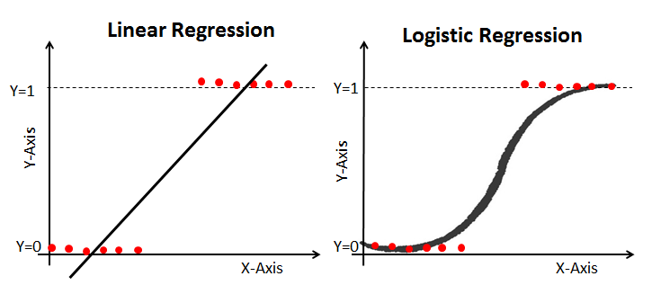
Logistic Regression
Notes:
Linear regression is estimated using Ordinary Least Squares (OLS) while logistic regression is estimated using Maximum Likelihood Estimation (MLE) approach.

Slide 29
Logistic Regression
Advantages
Efficient and straightforward (doesn't require high computation power)
Easy to implement
Easily interpretable
Used widely
Doesn't require scaling of features
Provides a probability score for observations
Disadvantages
Not able to handle a large number of categorical features/variables
Vulnerable to overfitting
Can’t solve the non-linear problem
Will not perform well with independent variables that are not correlated to the target variable and are very similar or correlated to each other

Slide 30
KNN Living Demo

Slide 31
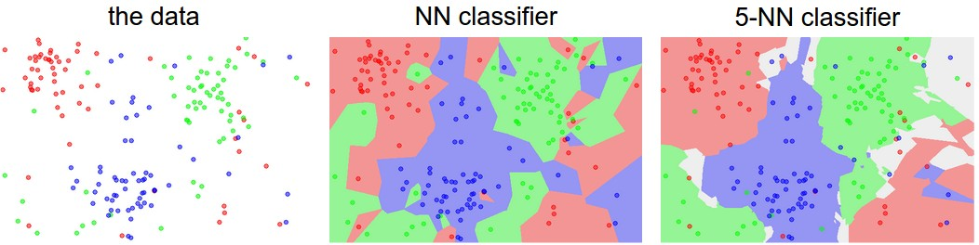
K-nearest Neighbors
From unknown point, pick k nearest neighbors
Majority class among those k points wins!

Slide 32
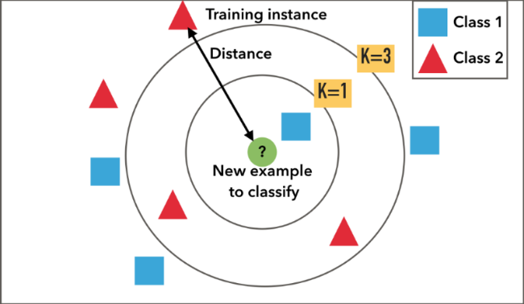
K-nearest Neighbors

Slide 33
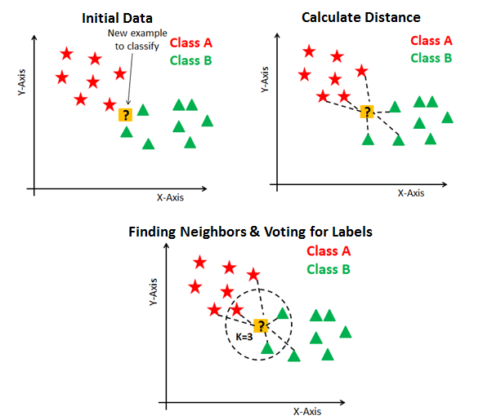

Slide 34
K-nearest neighbors
Non-parametric, lazy learning algorithm that predicts similarity based on “nearness” (similarity)
Non-parametric means makes no assumptions about underlying distribution of the data (much of our data doesn’t follow neat distributions)
Lazy means the training phase is minimal. Uses all (or nearly all) training data. (Testing phase is costly, though)
Spatial algorithm.

Slide 35
K-nearest Neighbors
How do we choose k?
Balance between under- and over-fitting.
Curse of dimensionality: feature space becomes increasingly sparse for an increasing number of dimensions. (neighbors may be far!)
How do we choose a distance metric?
Euclidean distance usually works for real values but important to standardize.
Both k and the distance measure are hyperparameters because we set them. The model doesn’t learn them.

Slide 36
K-nearest Neighbor
Advantages
Simple to understand and explain
Model training is fast
Can be used for classification or regression
Non-linear
Useful for Gene Expression, Protein-Protein Interactions, and 3-D Structure Prediction
Disadvantages
Must store all the training data
Prediction can be slow with large datasets
Sensitive to irrelevant features
Sensitive to the scale of the data
Accuracy may not be competitive with other algorithms
Curse of Dimensionality (works better with fewer features)

Slide 37
SVM Living Demo

Slide 38
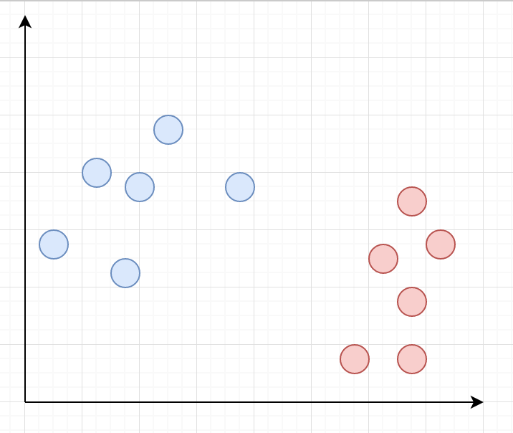
Support Vector Machine
Imagine we have red class and blue class, and plotted, they look like this graph.
What is the ideal separation boundary given this distribution?

Slide 39
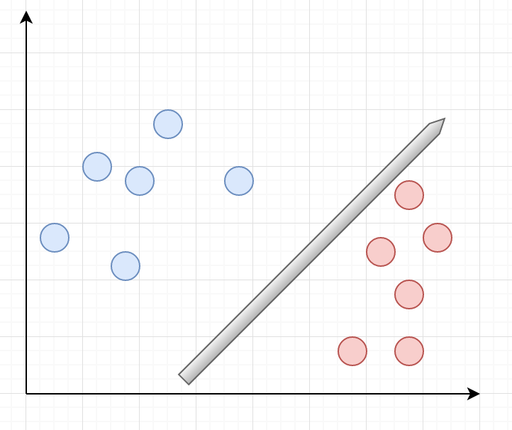
Support Vector Machine
Imagine we have red class and blue class, and plotted, they look like this graph.
Option 1

Slide 40
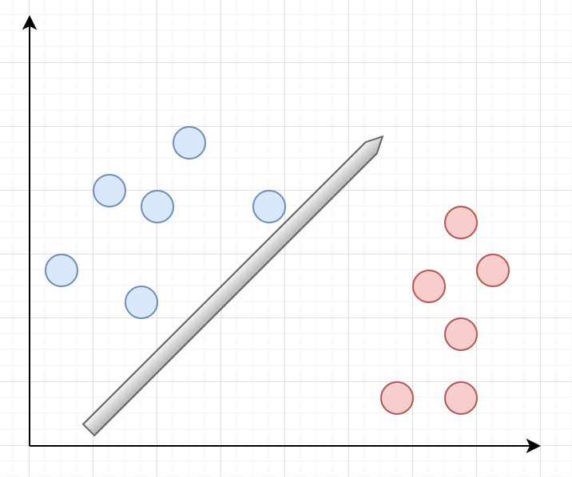
Support Vector Machine
Imagine we have red class and blue class, and plotted, they look like this graph.
Option 2

Slide 41
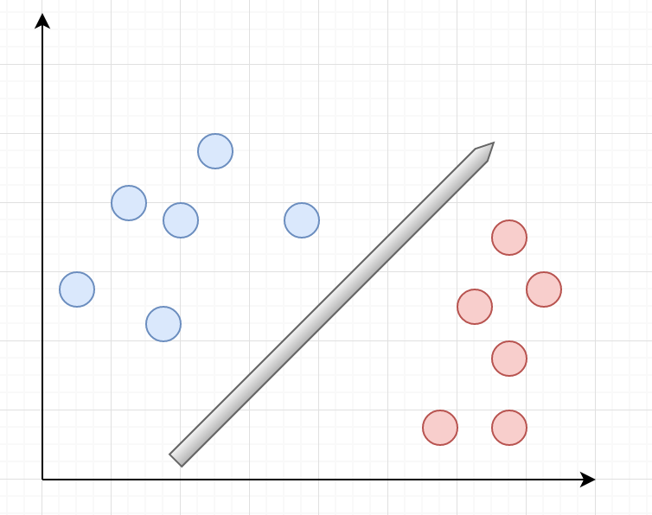
Support Vector Machine
Imagine we have red class and blue class, and plotted, they look like this graph.
Option 3

Slide 42
Support Vector Machine
Which is best?
Option 1
Option 2
Option 3

Slide 43
Support Vector Machine
Winner!
Option 1
Option 2
Option 3

Slide 44
Support Vector Machine
Winner. Why?
What specific conditions can you define that makes this optimal?
Option 3

Slide 45
Support Vector Machine
In general, lots of possible solutions for a,b,c.
Support vector machine finds an optimal solution (with respect to what cost?)

Slide 46
Support Vector Machine
A Support Vector Machine is a binary linear classifier whose decision boundary is explicitly constructed to minimize generalization error
Binary classifier: solves a two-class problem
Linear classifier: creates a linear decision boundary

Slide 47
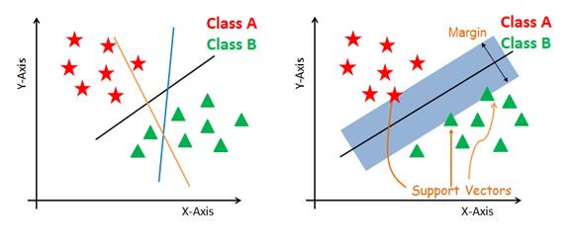
Support Vector Machines

Slide 48
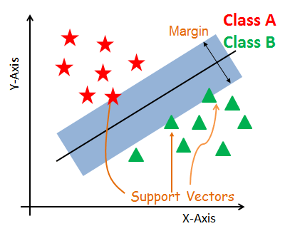
Support Vector Machine

Slide 49
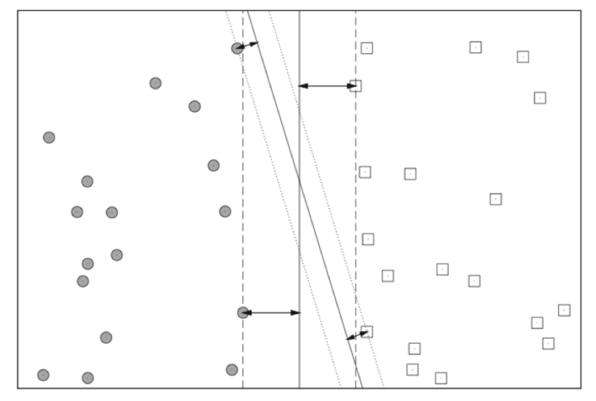
Support Vector Machine
The decision boundary is derived using geometric reasoning (as opposed to the algebraic reasoning we’ve used to derive other classifiers). The generalization error is equated with the geometric concept of margin, which is the region along the decision boundary that is free of data points.
Notes:
Note the vertical line has a higher margin
The goal of an SVM is to create the linear decision boundary with the largest margin. This is commonly called the maximum margin hyperplane (MMH).

Slide 50
SVM Pillowcase

Slide 51
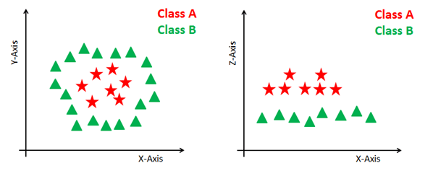
Support Vector Machine

Slide 52
Support Vector Machine
The goal of an SVM is to create the linear decision boundary with the largest margin. This is commonly called the maximum margin hyperplane (MMH).
Nonlinear applications of SVM rely on an implicit (nonlinear) mapping that sends vectors from the original feature space K into a higher-dimensional feature space K’. Nonlinear classification in K is then obtained by creating a linear decision boundary in K’. In practice, this involves no computations in the higher dimensional space, thanks to what is called the kernel trick.

Slide 53
Support Vector Machines
Linear Kernel: A linear kernel can be used as normal dot product any two given observations. The product between two vectors is the sum of the multiplication of each pair of input values. K(x, xi) = sum(x * xi)
Polynomial Kernel: A polynomial kernel is a more generalized form of the linear kernel. The polynomial kernel can distinguish curved or nonlinear input space. K(x,xi) = 1 + sum(x * xi)^d
Where d is the degree of the polynomial. d=1 is similar to the linear transformation. The degree needs to be manually specified in the learning algorithm.
Radial Basis Function Kernel The Radial basis function kernel is a popular kernel function commonly used in support vector machine classification. RBF can map an input space in infinite dimensional space. K(x,xi) = exp(-gamma * sum((x – xi^2))
Here gamma is a parameter, which ranges from 0 to 1. A higher value of gamma will perfectly fit the training dataset, which causes over-fitting. Gamma=0.1 is considered to be a good default value. The value of gamma needs to be manually specified in the learning algorithm.

Slide 54
Support Vector Machine: Hyperparameters
Kernel: Polynomial and RBF are useful for non-linear hyperplane.
Regularization: Regularization parameter in python's Scikit-learn C parameter used to maintain regularization. C is the penalty parameter, which represents misclassification or error term. A smaller value of C creates a small-margin hyperplane and a larger value of C creates a larger-margin hyperplane.
Gamma: A lower value of Gamma will loosely fit the training dataset, whereas a higher value of gamma will exactly fit the training dataset, which causes over-fitting.

Slide 55
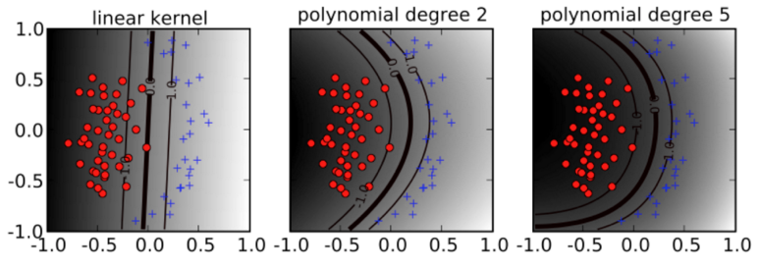
Support Vector Machine

Slide 56
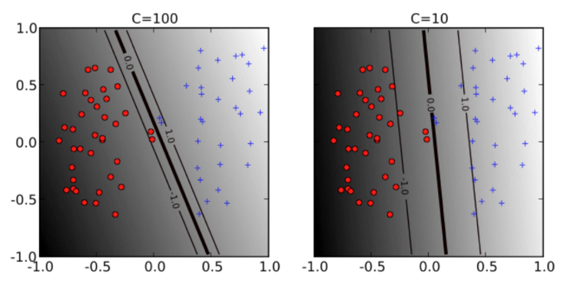
Support Vector Machines
Soft margin, slack variables-class overlap is achieved by relaxing the minimization problem or softening the margin.
The hyper-parameter C (soft-margin constant) controls the overall complexity by specifying penalty for training error. This is regularization.

Slide 57
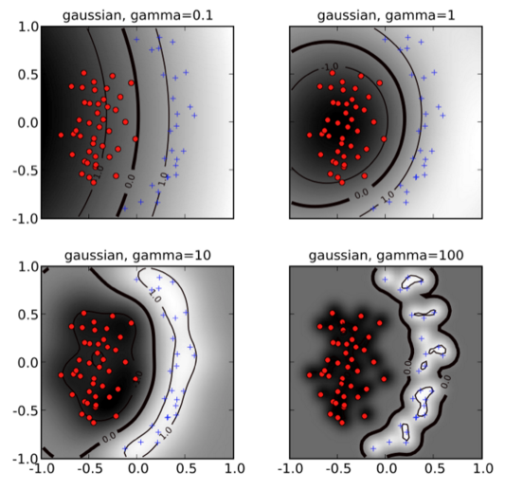
Support Vector Machine

Slide 58
Support Vector Machines
Advantages
Good accuracy and perform faster prediction.
Use less memory because they use a subset of training points in the decision phase.
SVM works well with a clear margin of separation and with high dimensional space.
Disadvantages
Not suitable for large datasets because of its high training time
Works poorly with overlapping classes.
Sensitive to the type of kernel used.

Slide 59
Decision Trees
In the game "20 Questions," an individual or group has the opportunity to identify an unknown object by asking a series of up to twenty "yes" or "no" questions.
We can think about all possible "target objects" and then ask questions that help us to quickly pare down the number of objects so that we can identify the true target in twenty of fewer questions.
When playing this game, what are some good strategies? What about poor strategies?
For example, suppose that I am trying to guess the item "marker" I might ask a series of questions like:
Is the object in this room? (Yes.)
Is the object within five feet of me? (Yes.)
Is the object larger than a loaf of bread? (No.)
Is there only one of these objects in the room? (No.)
Do you hold this object when you use it? (Yes.)
Is the object a pen? (No.)
Is the object a book? (No.)
Is the object a marker? (Yes!)

Slide 60

Decision Trees
Let’s play a game!
https://en.akinator.com/
How does this game work?

Slide 61
Decision Trees
Decision trees are a widely popular and powerful machine learning technique for both classification and regression problems.
To perform classification or regression, decision trees make sequential, hierarchical decisions about the outcome variable based on the predictor data.
Break down our data by asking a series of questions.
They are great if we care about interpretability.

Slide 62
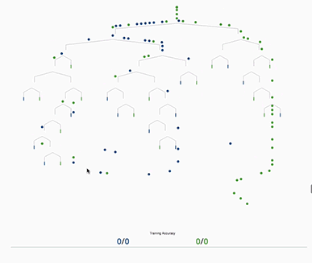

Slide 63
Decision Tree
Decision tree models are hierarchical and non-parametric.
Hierarchical means that the model is defined by a sequence of questions which yield a class label or value when applied to any observation. Once trained, the model behaves like a recipe, a series of "if this then that" conditions that yields a specific result for our input data.
Non-parametric methods stand in contrast to models like logistic regression or ordinary least squares regression. There are no underlying assumptions about the distribution of the data or the errors. Non-parametric models essentially start with no assumed parameters about the data and construct them based on the observed data.

Slide 64
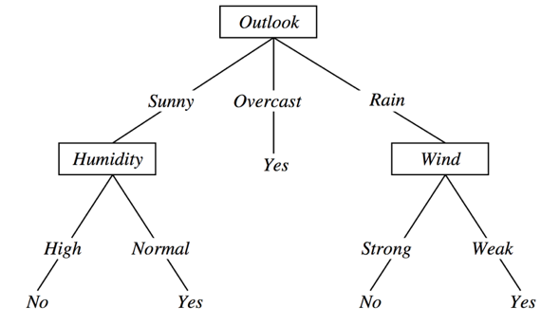
Decision Tree

Slide 65
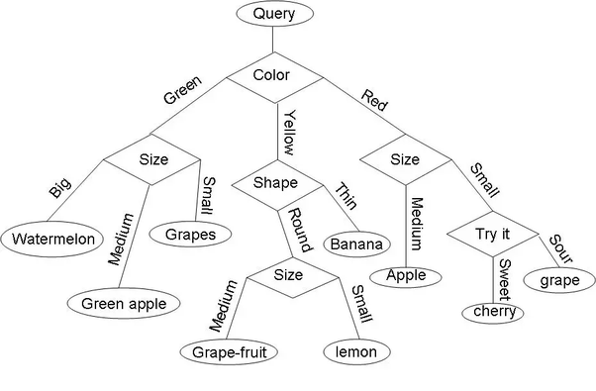
Fruit Decision Tree

Slide 66
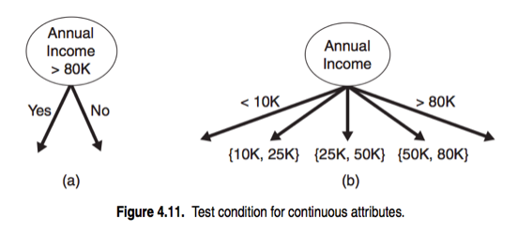
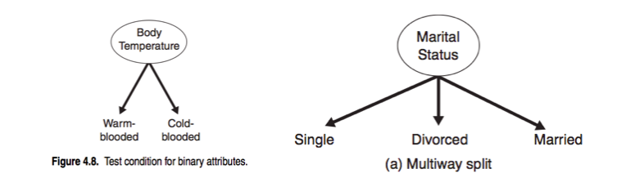
Decision Trees
Splits can be binary way or multi-way.
Features can be categorical or continuous.

Slide 67
Decision Trees
Start at the tree root and split the data on the feature that results in the largest information gain.
Repeat this splitting procedure until all the leaves are pure.
“Pure” means all the samples at each node belong to the same class.
This can result in a very “deep” tree with many nodes (overfitting).
So we usually want to prune trees by setting a maximum depth.

Slide 68
Decision Trees
Use an objective function to maximize information gain--splitting the nodes on the most informative features.
Information gain is the difference between the impurity of the parent node and the sum of the child node impurities. (Lower impurity of child nodes, the higher the information gain)

Slide 69
Decision Trees
Three impurity measures (splitting criteria):
Gini impurity (most used)
Entropy
Classification error
In practice, Gini and entropy yield pretty similar results and it’s more worth your time experimenting with different pruning cut-offs than with different impurity measures.
Classification error is useful for pruning but not for growing trees.

Slide 70
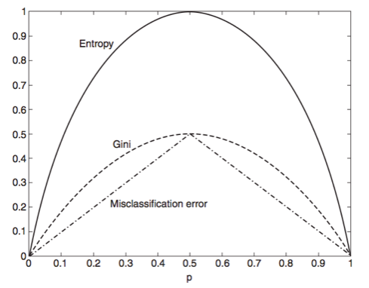
Decision Trees

Slide 71
Decision Trees
Addressing overfitting:
A stopping criterion determines when to no longer construct further nodes.
We can stop when all records belong to the same class, or when all records have the same attributes. This maximizes variance at the expense of bias, leading to overfitting.
Setting a maximum depth: A simple way to prevent overfitting is to set a hard limit on the "depth" of the decision tree.
Minimum observations to make a split: An alternative to maximum depth (and can be used at the same time), is to specify the minimum number of datapoints required to make a split at a node.

Slide 72
Decision Trees: Advantages
Simple to understand and interpret.
Requires little data preparation.
Able to handle both numerical and categorical data.
Uses a white box model (boolean logic)
Possible to validate a model using statistical tests. That makes it possible to account for the reliability of the model.
Robust. Performs well even if its assumptions are somewhat violated by the true model from which the data were generated.
Performs well with large datasets. Large amounts of data can be analyzed using standard computing resources in reasonable time.
Once trained can be implemented on hardware and has extremely fast execution.

Slide 73
Decision Trees: Disadvantages
Locally-optimal--practical decision-tree learning algorithms are based on heuristics such as the greedy algorithm where locally-optimal decisions are made at each node.
Such algorithms cannot guarantee to return the globally-optimal decision tree.
Overfitting--decision-tree learners can create over-complex trees that do not generalize well from the training data.
There are concepts that are hard to learn because decision trees do not express them easily.In such cases, the decision tree becomes prohibitively large.
Decision tree learners create biased trees if some classes dominate. It is therefore recommended to balance the dataset prior to fitting with the decision tree.

Slide 74
Classifiers: Pros and Cons
Decision trees are good if we care about interpretability but overfit easily.
Logistic regression allows us to predict probabilities.
Support vector machines are powerful linear models that can be extended to nonlinear problems but have lots of parameters to tune.
Ensemble methods (e.g. random forest) don’t need much parameter tuning and don’t overfit easily.
K-nearest neighbors makes predictions without any model training but is computationally expensive

Slide 76
